Slide 1
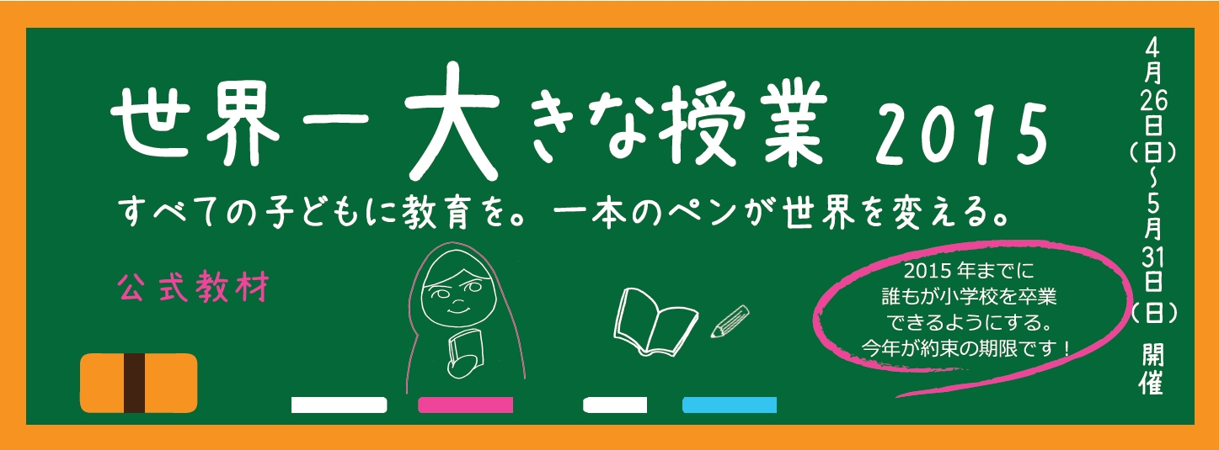
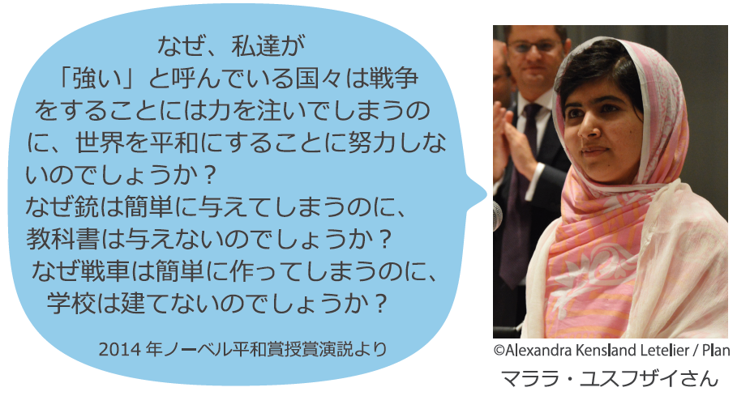
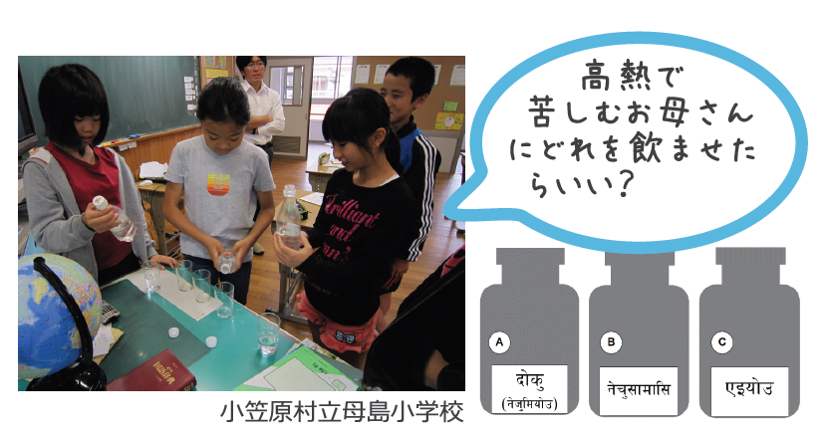

©GCE
©JNNE
Notes:
1
「これから授業を始めます。」授業のねらいを確認し、世界一大きな授業について説明する。
■Purpose of this teaching material
To learn about the educational situation in the world and consider the importance of education.
To be aware that there are children who are working for a better world and to think about what we can do ourselves.
To learn about current Japanese educational assistance.
“Why is it that countries which we call strong" are so powerful in creating wars but are so weak in bringing peace? Why is it that giving guns is so easy but giving books is so hard? Why is it, why is it that making tanks is so easy, but building schools is so hard?”
Malala’s Speech:

Slide 2

What is The Worlds’ Biggest Lesson?
There are still 57.8 million children who are not being able to go to school and 781 million illiterate adults.
In 2000, the international society set the “Education for All” goal to guarantee the right to education and promised to reach the goal by 2015.
“The world’s biggest lesson” is an event which holds a lesson all over the world at the same time, to deliver the participants’ voices to the government, hoping that they would reflect them to the education policies.
Let’s think about what we can do in Japan, by learning the situation of those children who are not able to go to school.

Slide 3

Let’s try! “The World’s Biggest Lesson” Quiz!
Activity 1
Q1 How many children in the world do not attend primary school?
A．One out of five (Approximately 140 million)
B．One out of twelve (Approximately 58 million)
C．One out of twenty five (Approximately 27 million)
D．One out of a hundred (Approximately 14 million)
One out of twelve！
Wow... So many children are still out of school…
Notes:
Q1 How many children in the world do not attend primary school?
Answer：B. One out of twelve
One out of twelve, which is approximately 57.8 million students are not able to go to primary school. The number of children who cannot go to school has decreased by 50 million since 1999 as a result of all developing nations, governments and international society’s efforts to increase educational funds, the abolishment of tuition fees and the rising quality of teachers. However, three quarters of this decrease was achieved from 1999 to 2004 and no progress has been seen between the years 2008 and 2010. There is no prospect of enrolling in school for the forty-seven out of a hundred students who cannot go to school today.

Slide 4
Let’s try! “The World’s Biggest Lesson” Quiz!
Activity 1
Q2 What are the possible reasons why children cannot attend primary school?
A．Because there are not enough schools and teachers
B．Because they have to work as their family is poor
C．Because parents or neighbors told them they do not need to go.
D．Because the school is broken by the wars and conflicts or unavailable because of the army.
All of them are correct！
Notes:
Q2 What are the possible reasons why children cannot go to primary school?
Answer： All are correct
All of the answers are correct. Various problems have caused this situation, such as war, poverty, lack of understanding for education and social discrimination against the weak such as girls or those with disabilities. For girls, they are often attacked on the way to school, and need to do housework such as getting water. They are also discouraged from going to school because there are no ‘girls only’ toilets. They also may not be able to drink clean water and there are often very few female teachers at school. In particular half of students who cannot go to primary school live in conflict areas and these students have increased from 2008. Over the past decade, in at least 25 countries schools have been used as military sites, shooting sites, a weapon stores and jails. Furthermore, within the 5 years, schools in 70 counties have been damaged due to political issues, military influence, ideology, cliques, religion and ethnicity.

Slide 5
Let’s try! “The World’s Biggest Lesson” Quiz!
Activity 1
Q3 How many children in the world drop out of primary school?
A．One out of three
B．One out of four
C．One out of ten
D．One out of twenty
One out of four children drop out of school…
Notes:
Q3 How many children in the world drop out of primary school?
Answer： B. One out of four
The enrolment rate has increased significantly as a consequence of the efforts of people in developing countries, governments and international society. However, there is a large number of children who quit primary or junior high school due to poverty, household chores and lack of understanding from family or neighbours after they get in. Particularly, one out of three point five students in developing countries and one out of two in Sub-Saharan Africa, drop out of school. The quality of education has also come to be a fundamental issue since one third of elementary school-aged students cannot acquire basic academic skills whether they got to school or not.

Slide 6
Let’s try! “The World’s Biggest Lesson” Quiz!
Activity 1
Q4 How many teachers are needed to have all the children educated at school ?
A．60 thousand
B．600 thousand
C．1 million
D．1.6 million
We need about
1.6 million teachers
Notes:
Q4 How many teachers are needed to have all the children educated at school ?
Answer： D. 1.6million teachers
Improvement of quality of education depends on the quality of teachers, but in reality, there are few qualified teachers and the salary paid is also insufficient. In one third of countries in the world, the number of primary school teachers who are trained at national level of programs is less than 75%.

Slide 7
Let’s try! “The World’s Biggest Lesson” Quiz!
Activity 1
Q5 Approximately how many adults in the world cannot read or write?
A．One out of two (Approximately 1.55 billion)
B．One out of six (Approximately 780 million)
C．One out of eighteen (Approximately 230 million)
D．One out of fifty (Approximately 60 million)
More than 700million
Notes:
Q5 Approximately how many adults in the world cannot read or write?
Answer： B. One out of six
780 million adults, which equals one out of six adults, are illiterate. Two thirds of them are women. When you are illiterate, you are not only disadvantaged as you cannot get access to essential information but you also cannot convey your own opinion on documents, which restricts your social rights.

Slide 8
What do you think would happen if you could not read or write?”
Activity 2-A
Notes:
Activity 2-A
■Introduction
Start with introductory phrases, such as “Through the previous quiz, we learned that one out of every six adults is illiterate. What do you think would happen if you cannot read or write?”
Watch the video on how to proceed with this activity. http://youtu.be/yTOTD7hQgbc
■How to lead activity 1
＜For primary/junior high school students, - Choosing a medicine bottle＞
Preparation：Put salt water, sugar water and just water in individual bottles. Cut off the labels below and attach label A, “poison,” to the salt water, label B, “antifebrile,” to the sugar water and label C, “nutrition,” to the water.
1. Read the story： Facilitator to read out the story below to the whole class.
2. Pick up a bottle： Either a group or an individual chooses which bottle to drink. Share which bottle they chose and why they chose the bottle with the whole class. After one representative of each group drinks from his/her bottle, the facilitator is to tell them the meaning of each label.
3. Reflection： Discuss how they felt when they chose the bottle and knew the meaning of the label with the whole class.
Story
Your mother is suffering from a high fever. However, there is no doctor in the village. To get to a doctor, you have to walk through mountain roads for a whole day and take a bus for seven hours. In the village, a teacher keeps a little bit of medicine at her house and she shares them in emergency situations. You visit the teacher’s place but she is out to town. You see some medicine bottles on the shelf but no one except the teacher can read what is written on the bottles. Though there are three familiar bottles which the teacher gave to you when you had a fever before, you cannot tell the difference. What do you do? What would happen if your mother drank from the bottle you picked?
■Printing Labels
The labels on the bottles, written in the characters used in Nepal and India, each means “A: Poison (for mice), “B: Antifebrile” and “C: Nutrition.”

Slide 9
What do you think you cannot do if you cannot read or write?
Activity 2-A
ลักษณะงาน: งานในสานักงาน
ระยะเวลาทางาน: 6 ชั่วโมงต่อวัน
ค่าจ้าง: 550 บาท
A
ลักษณะงาน: งานในสานักงาน
ระยะเวลาทางาน: 10 ชั่วโมงต่อวัน
ค่าจ้าง: 250 บาท
B
ลักษณะงาน: พนักงานเสิร์ฟ
ระยะเวลาทางาน: 8 ชั่วโมงต่อวัน
ระยะทาง: 500 เมตรจากสถานี
C
Notes:
■Ask questions
“What do you think you cannot do if you cannot read or write?”
Cannot read books/ cannot write your own names/ cannot calculate/ cannot read maps/ cannot behave confidently etc.
“What can you do when you can read and write?”
Can study, read books, use the internet, write letters, write emails, write novels, express yourself, get access to new information
■How to lead the activity 2
＜For high school/university students – Finding a job＞
Preparation: Print out the three advertisements A to C for all participants. Cut them into two pieces, tracing the perforated line (Thai / Japanese).
Read the ads：Pass out the Thai parts on the left to the groups and ask them to try to read them.
As a group, they decide which job they would apply for.
Share which adverts they chose and why they chose them as a group with the whole class.
The facilitator should explain the meaning of adverts A to C.
Reflection： Discuss with the whole class how they felt when they chose the adverts and found out the meaning of it.
Ask the question below and discuss with the whole class.

Slide 10
What do you think you cannot do if you cannot read or write?
Activity 2-A
・Job content: Desk work
・Working hours: 6 hours/day
・Salary: 550 Bhat
A
・Job Content: Desk Work
・Working hours: 10 hours/day
・Salary: 250 Bhat
B
・Job Content: Waiter/Waitress
・Working hours: 8 hours/day
・Distance: 500 meters from the station
C
Notes:
Job offer A ※Good salary
Job offer B ※Fair conditions
Job offer C ※Does not provide enough information.
■Commentary: What is literacy?
What is literacy?
Literacy is the ability to read, write and calculate which are all essential in daily life. Currently, 780 million adults, which equates to one in six, are illiterate. The number of illiterate students has decreased by 12% since 1990, but only 1% of this decrease has been accomplished since 2000. Particularly, 59% of adults in Sub-Saharan Africa have literacy and 41% of them are illiterate. Moreover, 60% of illiterate people are women. When you are illiterate, you are not only disadvantaged as you cannot get access to essential information but you also cannot convey your own opinion on documents, which restricts your social rights. As this has negative effects not only to individuals, but also to the development of the country and the region, literacy rate is used as a measurement of how much basic education is spread in the country.

Slide 11
Literacy Rate in the World
Activity 2-A
Resource：EFA Global Monitoring Report 2013/4、The UNESCO Institute od Statistics
Notes:
■Commentary: What is literacy?
What is literacy?
Literacy is the ability to read, write and calculate which are all essential in daily life. Currently, 780 million adults, which equates to one in six, are illiterate. The number of illiterate students has decreased by 12% since 1990, but only 1% of this decrease has been accomplished since 2000. Particularly, 59% of adults in Sub-Saharan Africa have literacy and 41% of them are illiterate. Moreover, 60% of illiterate people are women. When you are illiterate, you are not only disadvantaged as you cannot get access to essential information but you also cannot convey your own opinion on documents, which restricts your social rights. As this has negative effects not only to individuals, but also to the development of the country and the region, literacy rate is used as a measurement of how much basic education is spread in the country.

Slide 12
Quiz
Activity 2-B
Q How much do you think we need a year for all the children in the world to go to school and for all the adults to learn and how to read and write? ※Hint: Of the 95.9trillion yen of the whole Japanese budget, about 5.4 trillion yen was used for education and science.
A．10 trillion yen
B．8 trillion yen
C．5 trillion yen
D．1 trillion yen
It looks similar to
the budget for Education and Scientific sector in Japan
Notes:
Activity 2-Ｂ
（Answer：C．5 trillion yen）
■Introduction
Start with introductory phrases, such as “Through the previous quiz, we learned why children cannot go to school. One of the reasons was that the number of teachers and schools is insufficient. There are some problems which can be solved by increasing budgets and funds.”

Slide 13
Activity 2-B
For all children in the world to go to school and for all adults to learn how to read and write, 5.3 trillion yen per year is necessary.
Of this, the governments in developing nations can spend 4 trillion yen by increasing their educational budgets but as for the remaining 1.3 trillion yen, the developed nations need to assist.
Notes:
■Commentary: Funds for education
For all children in the world to go to school and for all the adults to learn how to read and write, 5.3 trillion yen per year is necessary. Of this, the governments in developing nations can spend 4 trillion yen by increasing their educational budgets but as for the remaining 1.3 trillion yen, the developed nations need assistance.
Of the necessary amount, however, only 300 billion yen has been spent in reality. Developed nations need to spend another 1 trillion yen. If developed nations shared the amount of money following the wealth of each country, Japan would need to provide 130 billion yen. However, the Japanese government currently supplies only 10.9 billion yen (2013). Japan needs to provide 12 times more than this.
The percentage of ODA for basic education is only 0.6%, which is less than half of 1.9% of other developed nations. On the other hand, a public opinion poll (Association of International Cooperation, 2009) shows that 39% of Japanese people think that the ODA needs to be used for educational support. Japanese people do think the ODA should be spent on helping poverty, public health, refugees, education, and those who are suffering from natural disasters. (Resource：OECD/DAC Data Base 2013, EFA Global Monitoring Report)

Slide 14
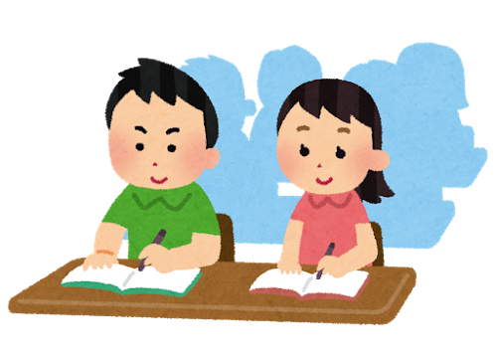

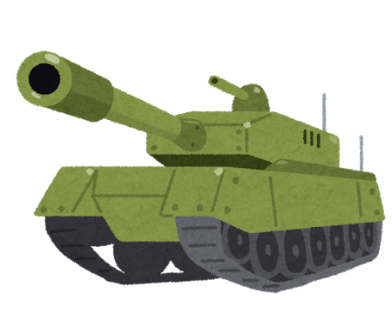
Activity 2-B
Education
Video Games
Military Funds
13cm=
1.3 trillion yen
63cm=
6.3 trillion yen
17m=
177 trillion
？
？
？
Notes:
■How to lead the activity
3. Compare the length of the ribbons: “How much is 1.3 trillion yen? Let’s compare it with the size of the video game market and military funds all over the world. Ask 3 pairs of students (six students in total) to come to the front of the class and pass the rolled ribbons to each pair. Ask one student to hold one end, have the ribbons stretched out in order and finally compare the lengths.
※It is effective to make the long ribbons straight so that everyone in the room can see the whole length of them. Also, before this activity begins, you should hide the actual size of each ribbon by putting them in a box or an envelope, so that everyone can enjoy the surprise.
※The necessary amount for children all over the world to go to school for a year with the
The education funds for all the children in the world can go to school for a year.: 1.3 trillion yen →13cm
Global video game market: 6.3 trillion yen (Famitsu, 2014) →63 cm
C: 177 trillion yen (Stockholm International Peace Research Institute, 2013)→17m
4 Tell the participants that children all over the world can go to school for a year with the military funds of just 3 days.
5. Reflection: Ask the whole class what they thought of the activity.
6. Exchange opinions: Discuss what might be possible if the educational funds increased.

Slide 15
Activity 2-B
For all the Children in the world can got to school for a year with the global military funds of 3 days.
1.3
Trillion yen
Global Military Funds
177 trillion yen
Notes:
In fact, all the children in the world can go to school for a year with the military funds of just 3 days.

Slide 16
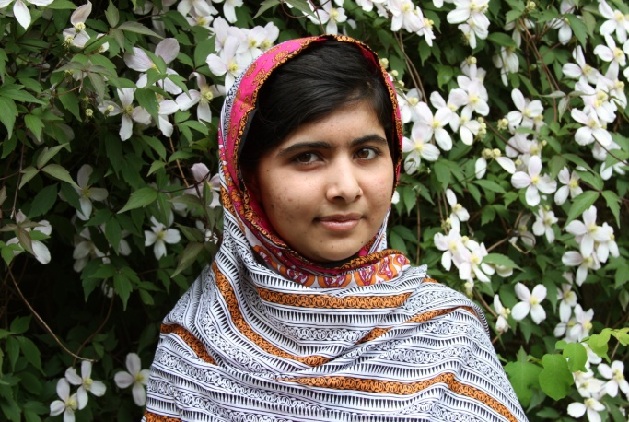
Malala Yousafzai’s speech at the Nobel Peace Prize Award Ceremony December 10, 2014
Activity 3
“Let this be the last time that a girl is forced into early child marriage.”
“Let this be the last time that a child loses life in war.”
“Let this be the last time that we see a child out of school.”
“Let this end with us.”
“Let's begin this ending.”
（C）A World at School 2013
Notes:
Activity 3
※別紙資料を配布する
■How to lead the activity
Hand out one of the two essays to each student. Tell them to read in silence.
Ask the students if there are any difficult words which they do not know or understand. Share those questions with the whole class.
Hand out the worksheet “How I am feeling now…”
As a small group of 4-6 participants, share what you wrote.
Share with the whole class.
■Materials
・Essays (2kinds/ Provide 1 for each participant)
・Worksheet – “How I am feeling now…”（p.18／1 for each participant）

Slide 17
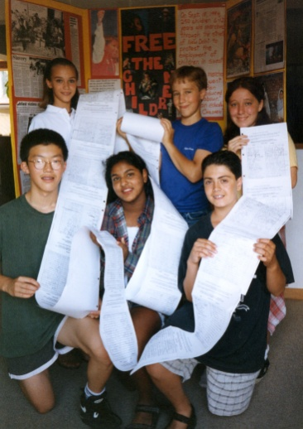
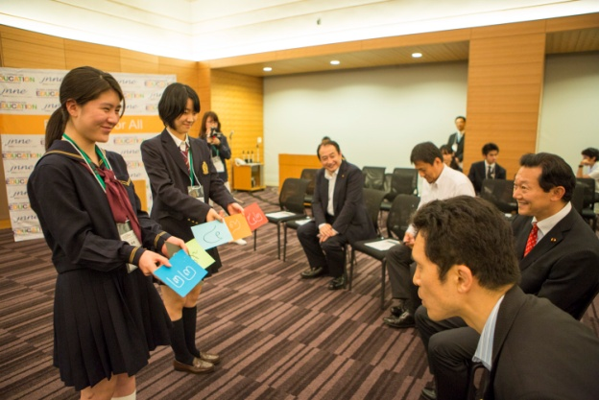
Children working on children’s issues The story of the Japanese children
Activity 3
Do you know there are teenagers who are playing an active role, wishing to do something to make the world better?
“Free the Children” is an international NGO that addresses the issues of children
We believe that being a child doesn’t mean we cannot do anything, there are some things we can tell others and play an active role.
Notes:
※別紙資料を配布する

Slide 18
How I am feeling now…
Activity 3
Surprised | Amazed | How sad
Angry | Lost | Worried
Not my concern | Unconvinced | Excited
Notes:
Activity 3
After reading the essays, circle the three that best fit what you are feeling now.
You can also write down any other feelings you have in the empty spaces.

Slide 19

Today we are going to discuss educational assistance for country C
Activity 4
Here are the 6 members attending this conference
（1）Provider of assistance, the government of county A
（2）Citizen of country A
（3）Provider of assistance, the government of country B
（4）Recipient of assistance, the government of country C
（5）The headmaster of a primary school in country C
（6）NGO staff
There are also some people coming from country of C
・The rest of the students stay outside of the conference as observers and take notes while the conference has held
Notes:
Activity 4：What is the necessary aid for education?
■How to lead the activity
1. Preparation: Set 2 tables at center of the classroom (or front) and prepare 6 and 8 chairs for each.
2. Description: The facilitator says “Today, we carry out the conference for educational assistance for the economically poor country C” to everyone.
3. Sharing the situation: Give the worksheet to everyone and the facilitator gives information about country C to everyone as well.
4. Gather the members: The facilitator asks “now, I will gather 14 members for the conference, so those who want to attend the conference, please come up front” to everyone. The rest of the students stay outside of the conference as observers and take notes while the conference is held.
5. Divide the role card A: each member is given a role card A face down.
6. Sit down (14 members): Those who have “Recipient of assistance, the government of country C” and “The headmaster of country C” sit at one side of the table.
“Provider of assistance, the government of county A”, “Citizen of country A” and “NGO” sit at the opposite side of the table. “Provider of assistance, the government of country B” sits between them. The rest of “Citizen of country C” sits another table.
7. Divide the pair of Role card B and Aid card: Give card B which has each role player’s description to the members as well as the Aid Card and let them read silently.
8. Introduce each member and start the conference: The facilitator starts to introduce the description by saying “Now we are in county C. Today we are going to discuss the educational assistance for country C. Here are 6 members attending this conference on behalf of the government of each country, NGO, a citizen from country of A, and a headmaster of primary school in country C, so now let me introduce more about each member. (Each member stands and shows what they are going to be) There are also some people who come from country C. (Show everyone where they are sitting) Now, let’s let them start the meeting!!!! (Begin with the first speaker)
9. Carry out the conference (Role Play) & show the Aid card: 6 of the participants speak in order following the Role Card and at the same time, put the Aid Card on the table. The facilitator writes the content of each Aid card on the board so that everyone is able to understand each statement. Ex2
10. Questions and Answers: After the NGO’s statement, the facilitator says “All right people, thank you so much. Now, let’s discuss the Educational Assistance for country C more with 6 members. Anyone who has questions to the members can start.” If no one has any then the facilitator can ask the members randomly.
11. Finishing the conference: If all the Questions and Answers are finished and the discussion can no longer continue, then the facilitator gives the headmaster of a primary school in country C the opportunity to speak.
12. Show everyone the statement for the citizens in country C & the Aid Card: The facilitator says “So let’s ask to the people who come from country C about what they think. Please introduce yourselves.” The people of country C speak with the Role Card in random order and put the Aid Card on the table. The facilitator writes them down on the board so that everyone is able to understand.
13. Finishing the Role Play and Reflection: The facilitator says “Thank you so much for your attendance and your contribution to the meeting of Educational Assistance for country C. Now I will close the conference.”
The teacher asks the students the following questions as a reflection.
Those who were in country C, what were your feelings seeing the discussion?
Were there any differences between the contents of educational assistance that were discussed during the conference and the need of the recipient country?
What country do you think country A represents?
How is it possible to provide realistic educational assistance based on need?
IF YOU HAVE TIME…..
14. Let’s learn more about the Japanese government’s educational assistance: Let’s learn more about the Japanese government’s educational assistance: Give the handout (source1) to everyone and tell them that country A represented the Japanese Government.
15. Read the NGO statement: Give the handout (source2) to everyone and introduce the NGO’s statement to the Japanese government
→it could also linked to “ Activity 5; Let’s propose policy”

Slide 20
What is country C like?
Activity 4
Country C is so-called “developing country”.
・It doesn’t have resources such as oil, natural gases, minerals, and it doesn’t develop industrially.
・This country has been independent for 30 years ago but civil wars have still continued.
80% of citizens live by farming, but it can hardly be said their lives are rich because grounds go wild and crops wither in the dry season.
・The literary rate is low at 60% and there are many educational problems.
Notes:
Activity4
What iscountry C like?
Country C is a so-called “developing country.” It doesn’t have resources such as oil, natural gases, minerals, and it doesn’t develop industrially. This country has been independent for 30 years ago but civil wars have still continued.
80% of citizens live by farming, but it can hardly be said their lives are rich because grounds go wild and crops wither in the dry season. In addition, the literary rate is low at 60% and there are many educational problems.

Slide 21
Activity 4
The aid the provider country wants to give | The aid of the recipient country wants
Higher Education (the government of A) | Budget for education （the government of country C）
Accept 100 foreign students to universities (the government of A) | Teachers・materials （Headmaster in country C）
300 used pencils (Citizen of A） | Increasing teachers’ salary （Headmaster in country C）
Basic Education (the government of B) | Teacher Training（A Teacher in country C）
 | A teacher good at teaching （A boy in country C）
 | Abolition of child labor Education opportunity for girls (A Girl in country C)
 | Prohibition of military use of educational facilities （A boy in country C）
 | Sufficient number of teachers （A Girl in country C）
 | Education opportunity for handicapped children （A boy in country C）
Notes:
Activity4
Finishing the Role Play and Reflection: The facilitator says “Thank you so much for your attendance and your contribution to the meeting of Educational Assistance for country C. Now I will close the conference.”
The teacher asks the students the following questions as a reflection.
1. Those who were in country C, what were your feelings seeing the discussion?
2. Were there any differences between the contents of educational assistance that were discussed during the conference and the need of the recipient country?
3. What country do you think country A represents?
4. How is it possible to provide realistic educational assistance based on need?

Slide 22
Activity 4
What can we see from the educational aid ?
1. The allocation to middle income countries (such as Asia) is bigger than the low income countries (such as Sub-Saharan Africa).
2. The allocation to higher education (specifically to scholarships for international students) is bigger, while that to basic education is smaller.
※出典：OECD Creditor reporting system 2013年の二国間援助支出総額
Notes:
Activity4
What can we see from the educational aid of the Japanese government ?
1. The allocation to middle income countries (such as Asia) is bigger than the low income countries (such as Sub-Saharan Africa).
2. The allocation to higher education (specifically to scholarships for international students) is bigger, while that to basic education is smaller.

Slide 23
Activity 4
Four recommendations for Japan’s aid to basic education by NGOs
Notes:
Activity4
JNNE, Japanese NGO Network, which is working for education strongly urges the Japanese government to:
1：Increase allocation of ODA to basic education
2：Prioritize low income countries and fragile states.
3：Expand financial support.
4：More contribution to Global Partnership for Education Fund (GPE Fund).

Slide 24
Activity 4
Amount of contribution to GPE Fund (2015)
※出典： Global Partnership for Education, Final Pledge Report – Second Replenishment Pledging Conference, 2014.
Notes:
Activity4
GPE Fund is an international organization to increase the volume and efficiency of funds devoted to education and to ensure that every child can go to school and learn.
It targets 60 low-income countries. Japan’s contribution is smaller than that of Ireland whose population is 4.8 million. (The amount of contribution was converted to Japanese yen using the exchange rate on February 2nd, 2015.)

Slide 25
For all the children in the world to be in school… Choose what you think is important from A to I and put them into each diamond, with the most important at the very top.
Activity 4
A. Appeal to Japanese politicians so that all children in the world can go to school.
B. Donate money and goods to some education related NGOs.
C. Go ahead and build schools in developing countries.
D. Do more research on the importance of education and lives in developing countries.
E. Share the importance of education with many people at school festivals.
F. Do nothing in particular.
G. Promote activities of international cultural exchange and make friends with people from other countries.
H. Share my thoughts with family and friends.
I. Post my opinion in newspapers.
Notes:
Activity4
■How to lead this activity
The facilitator asks the question below, “Looking at the world, more than 57 million children cannot attend school. What can we do for all the children in the world to be able to go to school?
Diamond Ranking: Hand out the diamond ranking worksheet to each participant. Participants are to work on their own. Then, participants should make small groups of four to six participants and share what they wrote on the sheet within the group. They can ask each other questions if needed. Make sure to tell the participants to really listen to each other as there is no correct answer for the sheet.
Policy suggestion：As a group, fill out the “policy suggestion worksheet” based on the previous discussion on the “diamond ranking”
Share with the whole class.
Advanced Activity
You may read “the letter to Prime Minister Shinzo Abe from Ms. Malala Yousafzai”as an advanced activity. (p.37)

Slide 26
Let’s Propose a Policy
Activity 4
●School/ Group：
●Number of people：
●Names：
●Our Proposal
For all the children in the world to go to school, I wish the Japanese government would consider…
●Our opinions and thoughts upon taking “The World’s Biggest Lesson”
Notes:
Activity4

